Slide 1


Forecast Exchange Rates

Slide 2
What is Exchange Rates?
An exchange rate is the value of one nation's currency versus the currency of another nation or economic zone.
For example, How many INR it will be for 1 USD?
As of June 25, 2021, the exchange rate is $1, meaning it takes $1 to buy 74.25 INR.

Slide 3
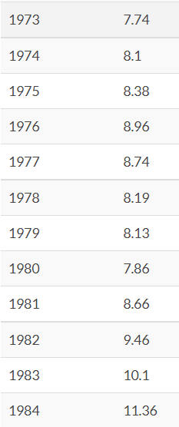
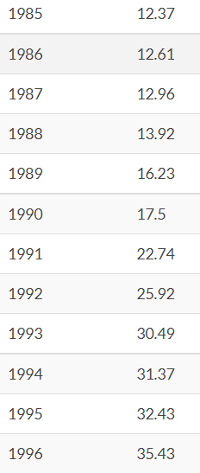
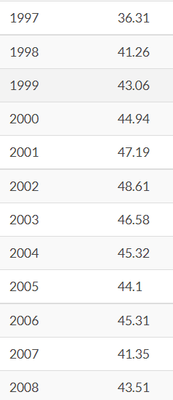
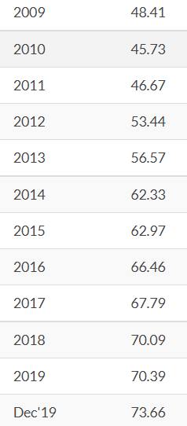
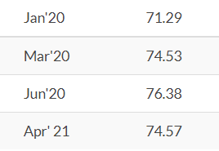
What’s been the value of 1 USD to INR since 1973 till date?
The 1 USD to INR exchange rate has always had extreme volatility since the inception and seen plethora of fluctuations over the years. We have brought you 1 USD to INR values table ranging all the way from 1973 till date so that you can see the change in INR’s value.

Slide 4
Objective
Data provided is related to USD/INR Exchange rates. The objective is to understand the underlying structure in your dataset and come up with a suitable forecasting model which can effectively forecast USD/INR exchange rate for next 30 days.

Slide 5
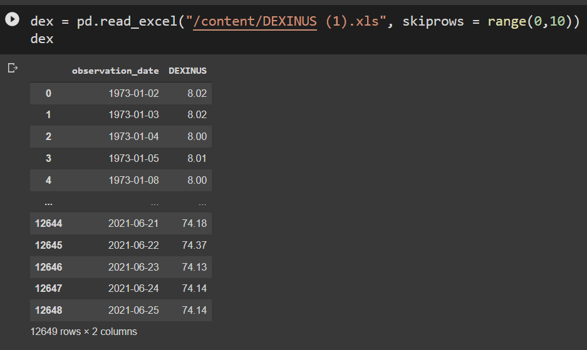
Load Data
Used skiprows to skip the rows from range(0,10)

Slide 6
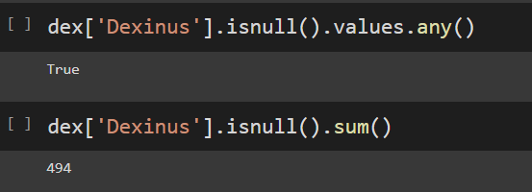
Checking for NULL Values
Use the ISNULL function to test whether a variable is the null value. If variable is the null value, 1 (true) is returned, otherwise 0 (false) is returned. This is the only way to test for the null value since the null value is not equal to any value, including itself.

Slide 7
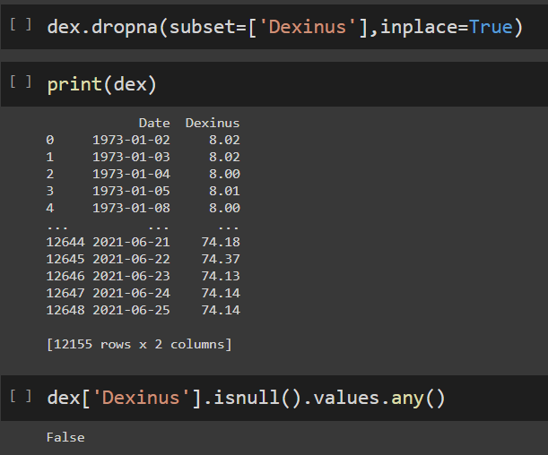
Removing the NULL Values using dropna() function
dropna() function is used to remove rows and columns with Null/NaN values.

Slide 8
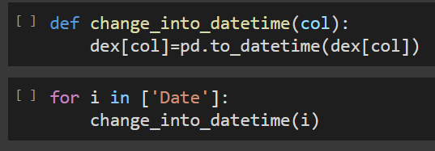
Convert strings to datetime
Pd.to_datetime that can be used to convert strings to datetime.

Slide 9
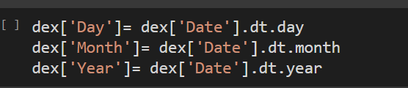
Get year, month, and day
dt.year,dt.month,dt.day are the inbuilt attributes to get year, month , and day from Pandas datetime object.

Slide 10
Display the Pandas DataFrame in Heatmap style
A heatmap is a matrix kind of 2-dimensional figure which gives a visualisation of numerical data in the form of cells. Each cell of the heatmap is coloured and the shades of colour represent some kind of relationship of the value with the dataframe.

Slide 11
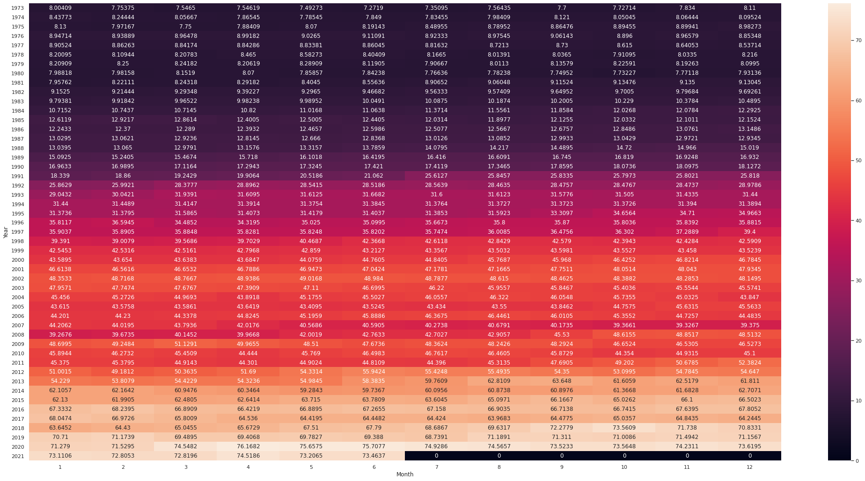

Slide 12
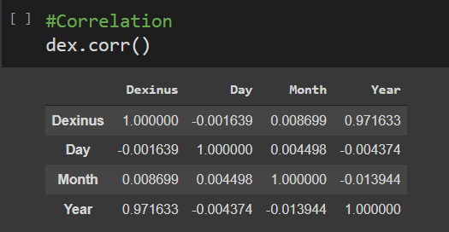
Dataframe.corr()
Dataframe.corr() is used to find the pairwise correlation of all columns in the dataframe. Any na values are automatically excluded. For any non-numeric data type columns in the dataframe it is ignored.

Slide 13
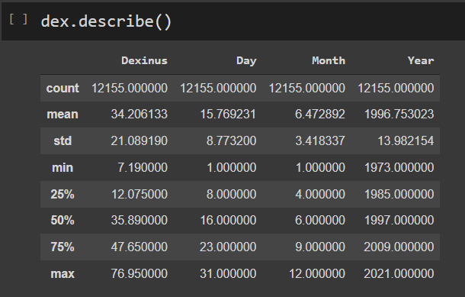
Describe Data()
describe() is used to view some basic statistical details like percentile, mean, std etc. of a data frame or a series of numeric values.

Slide 14
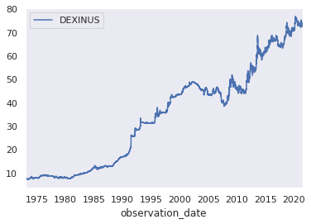
Time Series Plot or Line Plot
A line plot is a graphical display that visually represents the correlation between certain variables or changes in data over time using several points, usually ordered in their x-axis value, that are connected by straight line segments. The independent variable is represented in the x-axis while the y-axis represents the data that is changing depending on the x-axis variable, aka the dependent variable.

Slide 15
Time Series Decomposition Plot
Time series decomposition involves thinking of a series as a combination of level, trend, seasonality, and noise components.
Decomposition provides a useful abstract model for thinking about time series generally and for better understanding problems during time series analysis and forecasting.
Trend: The increasing or decreasing value in the series.
Seasonality: The repeating short-term cycle in the series.
Residuals: The “residuals” in a time series model are what is left over after fitting a model.

Slide 16
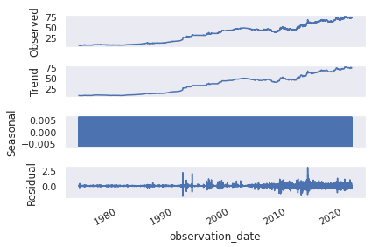

Slide 17
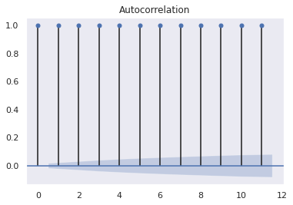
ACF & PACF Plot
ACF plot is a bar chart of coefficients of correlation between a time series and it lagged values. ACF explains how the present value of a given time series is correlated with the past values.
x-axis- expresses the correlation coefficient
y-axis-mentions the number of lags.

Slide 18
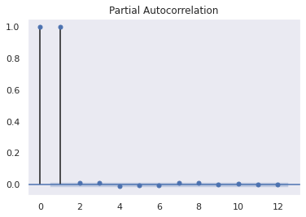
PACF is the partial autocorrelation function that explains the partial correlation between the series and lags of itself.

Slide 19
INTRODUCTION TO STATIONARY & NON-STATIONARY SERIES
The difference between stationary and non-stationary signals is that the properties of a stationary process signal do not change with time, while a Non-stationary signal is process is inconsistent with time.
What if the Data is not Stationary?
Non-stationary data, as a rule, are unpredictable and cannot be modeled or forecasted. The results obtained by using non-stationary time series may be spurious in that they may indicate a relationship between two variables where one does not exist.
To convert the data in stationary
Differencing is a popular and widely used data transform for making time series data stationary.
Differencing can help stabilize the mean of the time series by removing changes in the level of a time series, and so eliminating (or reducing) trend and seasonality.

Slide 20
Augmented Dickey-Fuller (ADF) Test
Augmented Dickey Fuller test (ADF Test) is a common statistical test used to test whether a given Time series is stationary or not. It is one of the most commonly used statistical test when it comes to analyzing the stationary of a series.
A Dickey-Fuller test is a unit root test that tests the null hypothesis that α=1 in the following model equation. alpha is the coefficient of the first lag on Y.
Null Hypothesis (H0): alpha=1
Alternate Hypothesis (Ha) or (H1)
Null Hypothesis (H0): alpha=1
The ADF test expands the Dickey-Fuller test equation to include high order regressive process in the model.
The statsmodel package provides a reliable implementation of the ADF test via the adfuller() function in statsmodels.tsa.stattools. It returns the following outputs:
1) The p-value
2) The value of the test statistic
3) Number of lags considered for the test
4) The critical value cutoffs.

Slide 21
INTRODUCTION TO UPSAMPLING & DOWNSAMPLING
Upsampling:-Increasing the rate of already sampled signal is Upsampling.
Interpolating the missing values:-
Linear interpolation means to estimate the unknown value in the same increasing order from previous values
Downsampling:-decreasing the rate is called downsampling.

Slide 22
Transformations
Two types of transformations:-
SQUARE ROOT TRANSFORM & LOG TRANSFORM:-They calculate relationship between variability and mean.

Slide 23
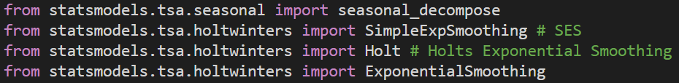
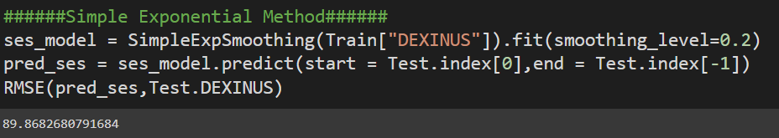
Data Driven Model
Evaluation Metric RMSE
RMSE is square root of mean squared error.
Importing Libraries for creating models:-
Simple Exponential Smoothing:-
Simple Exponential Smoothing, is a time series forecasting method for univariate data without a trend or seasonality.
Now we build the model

Slide 24
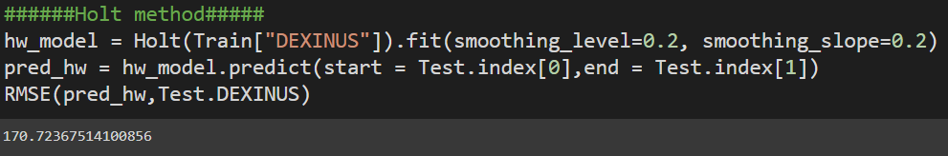
Holt Method
Holt's two-parameter model, also known as linear exponential smoothing, is a popular smoothing model for forecasting data with trend. Holt's model has three separate equations that work together to generate a final forecast.The method is also called double exponential smoothing or trend-enhanced exponential smoothing.

Slide 25
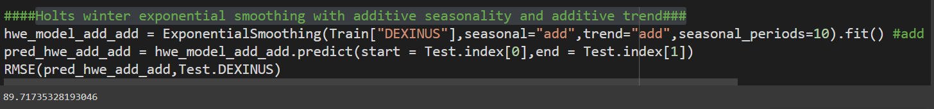
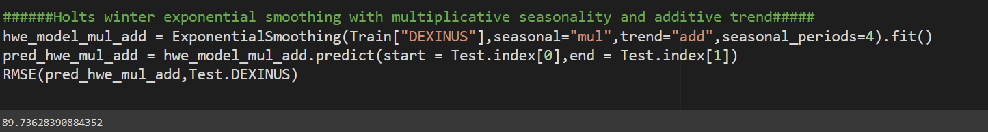
Holts winter exponential smoothing with additive seasonality and additive trend
Exponential smoothing with additive seasonality & additive trend.
This model will add the trend to the model.
Holts winter exponential smoothing with multiplicative seasonality and additive trend
Exponential smoothing with multiplicative seasonality & additive trend

Slide 26
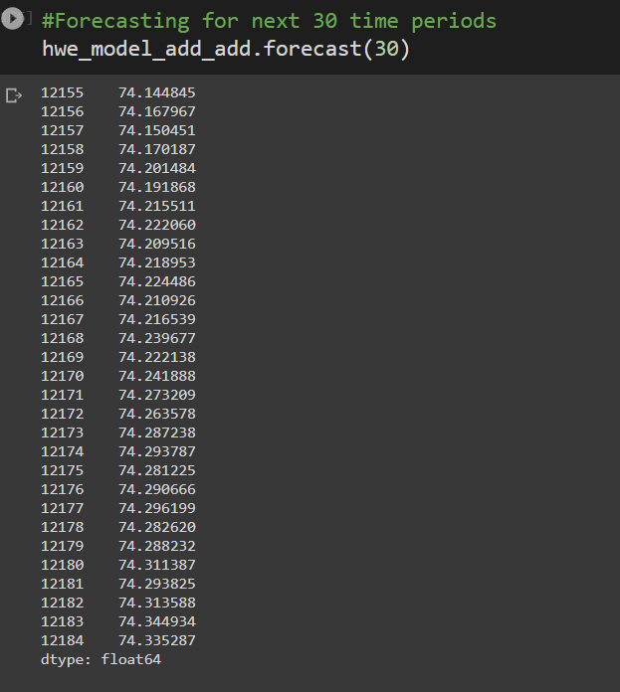
Final Model by combining train and test
Here, now we finalized the model by combining train & test
& by using holt winter exponential additive to forecast next 30 days time periods

Slide 27
NEURAL NETWORK
LSTM (Recurrent Neural Network)

Slide 28
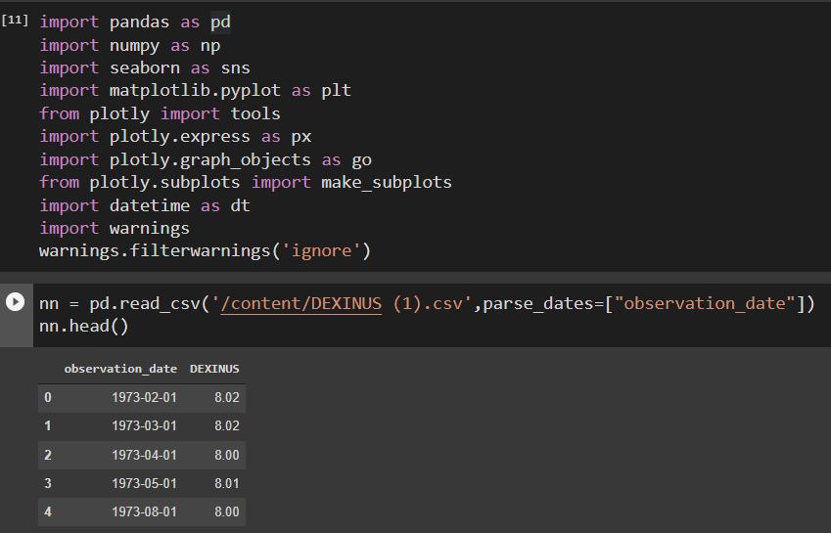
Importing necessary libraries & load the data using pandas.read_csv()
Function.

Slide 29
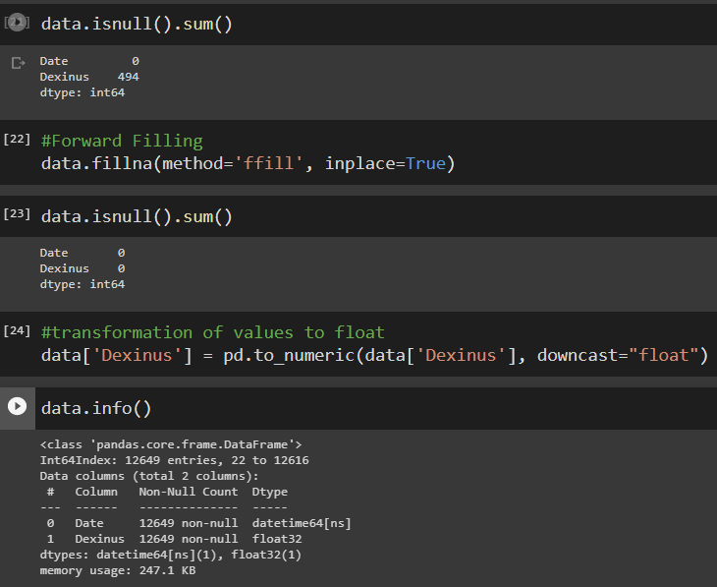
I’ve also fill the null values from the dataset using forward fill
ffill() function will fill the missing values and will propagate last valid observation forward.
I’ve transformed values to float by using to_numeric function and its argument downcast.This will take a numeric type-float & then downcast it to smallest version.

Slide 30
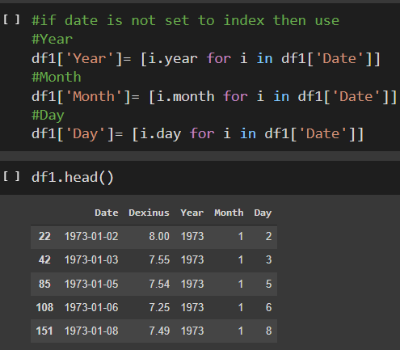
I also rename the columns as “Date” and “Dexinus” and I’ve not set Date as index so I segregated into “Year”, “Month” & “Day”

Slide 31
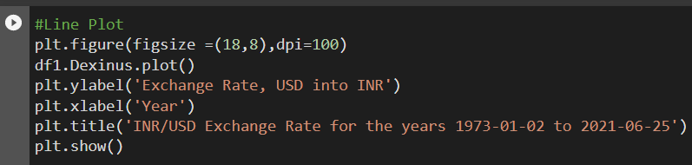
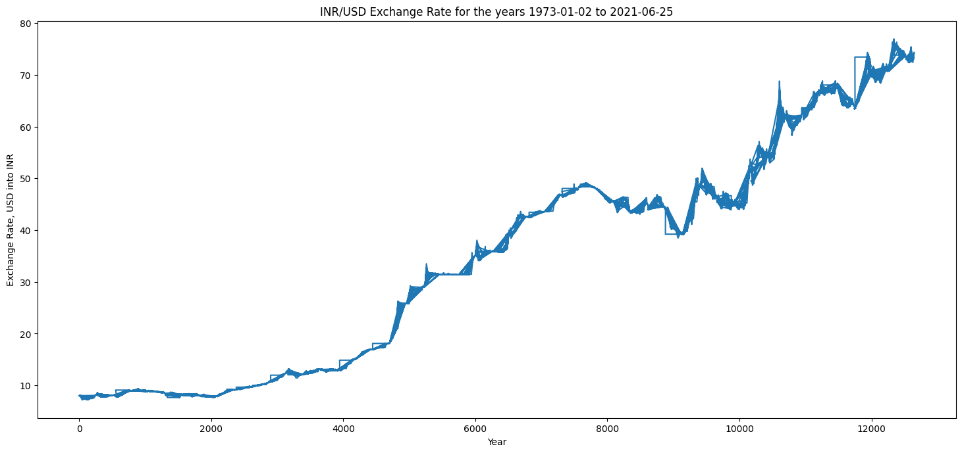
LINE PLOT
I plotted the line plot of exchange rate & year from 1973-01-02 to 2021-06-25.

Slide 32
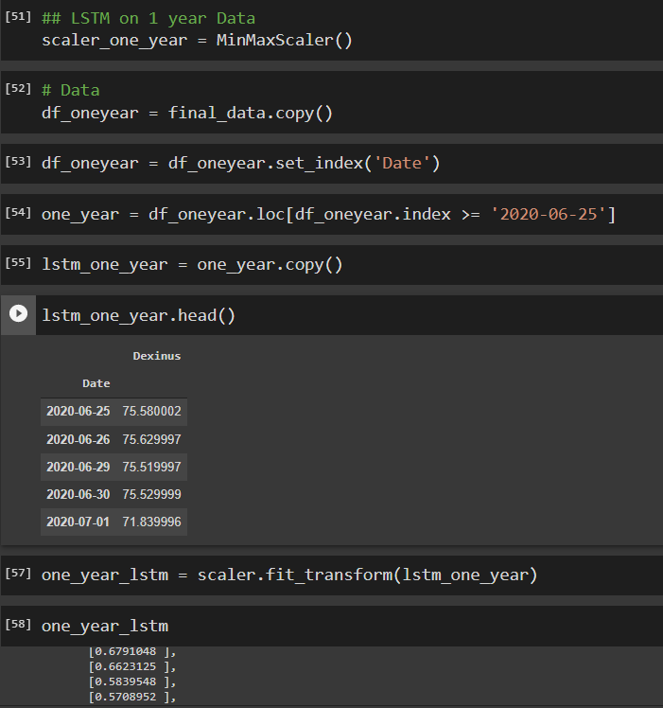
LSTM of one year data
I took LSTM of one year data.LSTMs are sensitive to the scale of the input data, specifically when the sigmoid (default) or tanh activation functions are used. It can be a good practice to rescale the data to the range of 0-to-1, also called normalizing. We can easily normalize the dataset using the MinMaxScaler preprocessing class from the scikit-learn library.

Slide 33
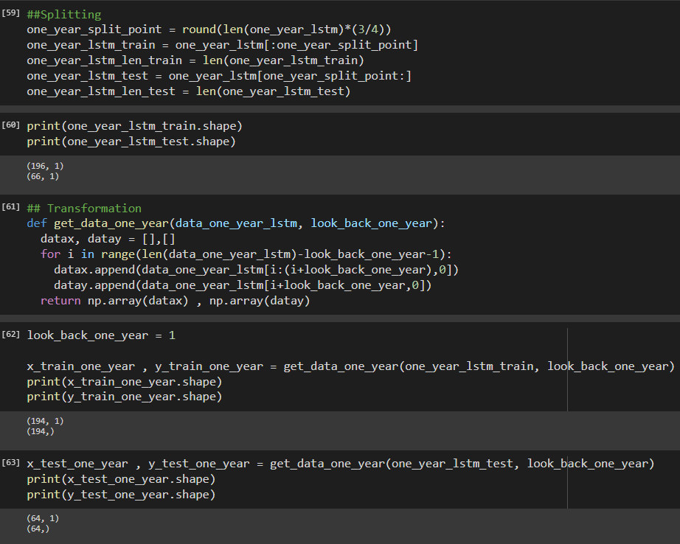
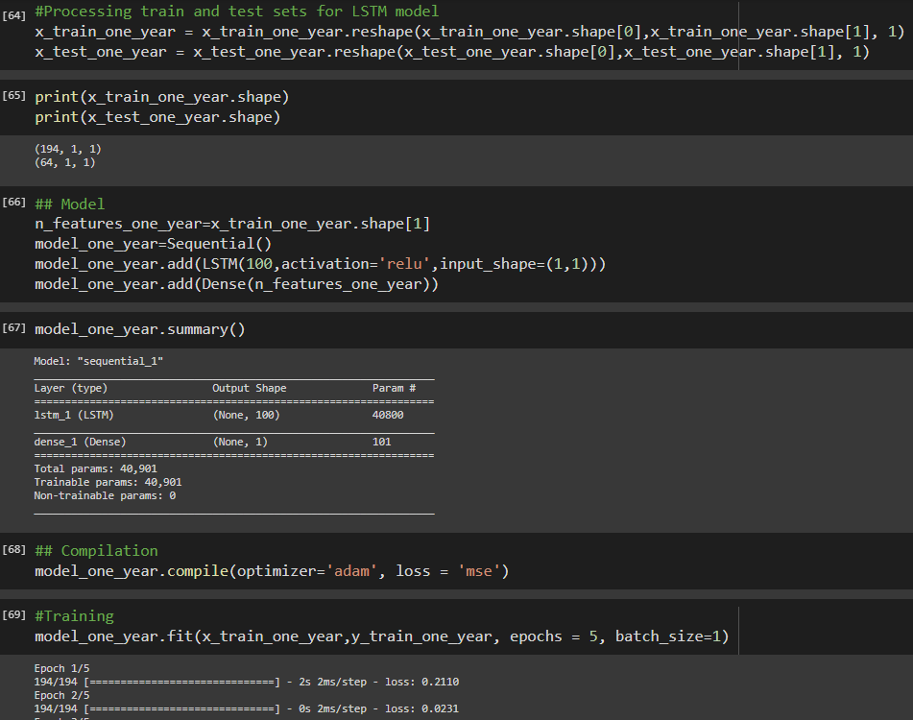
~ I splitted the data in train & test & transform the data of one year.
~ Processed the train & test set for LSTM Model, Reshape simply gives a new shape to an array without changing its data & shape simply gives a tuple of array dimensions and can be used to change the dimensions of an array.
~ Then I did model & summarised the one year of model, after that I compiled & trained the model.
~ Look back is nothing but the number of previous days’ data to use, to predict the value for the next day.

Slide 34
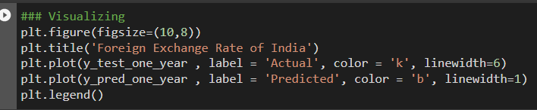
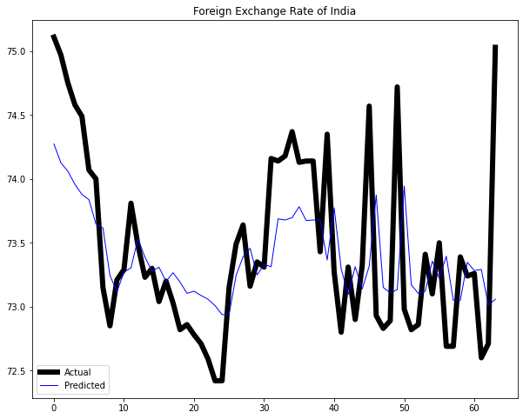
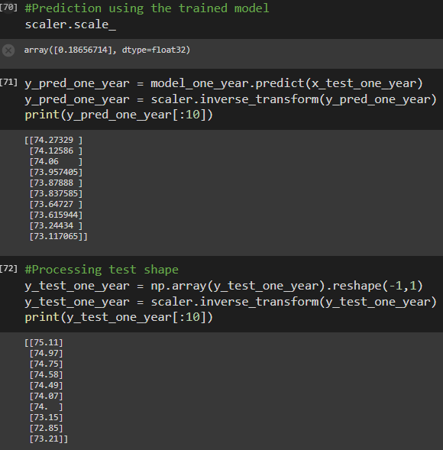
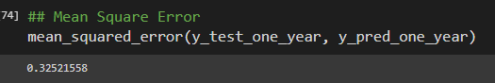
~ I predicted again using trained model & processed the test shape.
~ Visualization on actual & predicted of one year.
& lastly, I calculated MSE of one year.

Slide 35
Facebook Prophet

Slide 36
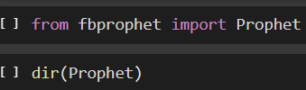
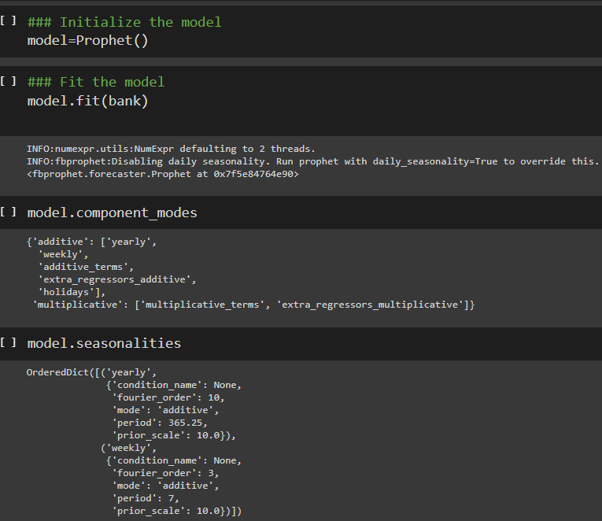
~ Firstly, I've imported fbprophet.
~ I took directory prophet
~ Then, I initialize the model & fit the
model.

Slide 37
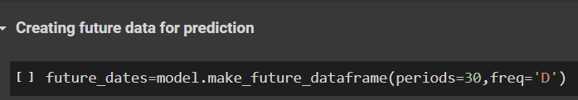
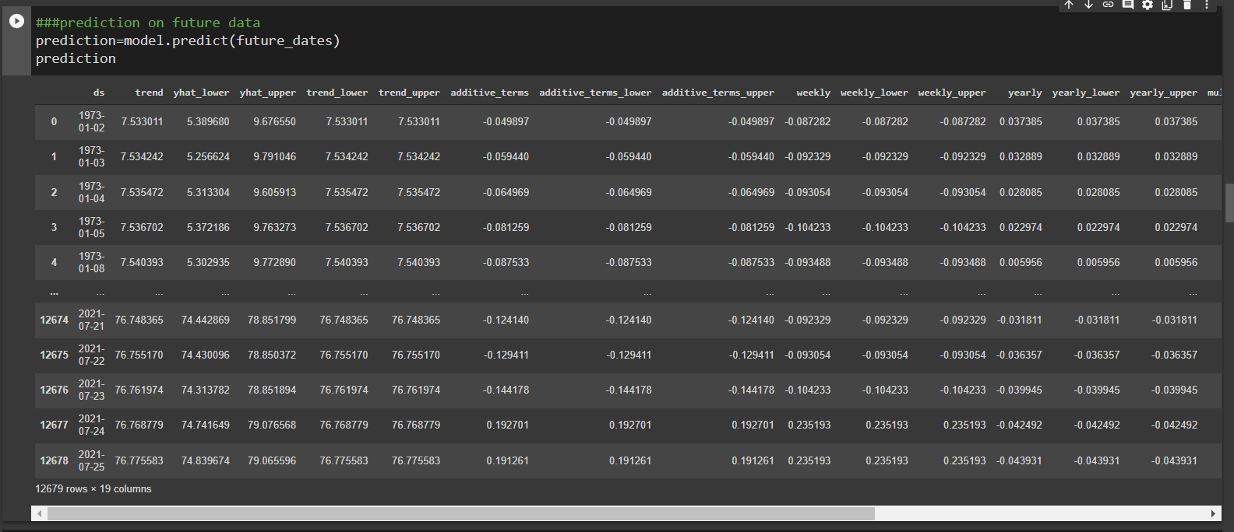
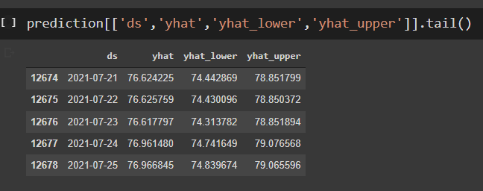
~ Now, I created the future data for prediction
~ I predicted the model on future_dates
~ I don’t need whole table, so I took particular columns I wanted.

Slide 38
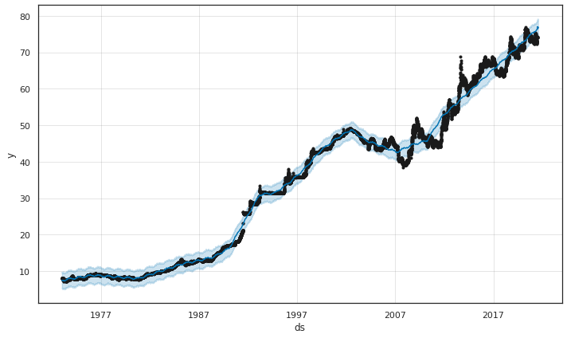
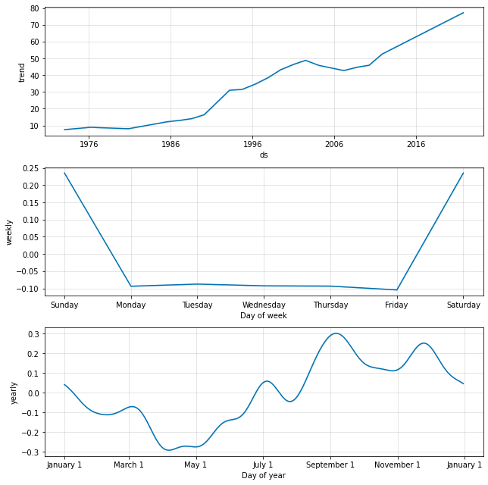
~ I visualized my prediction.
~ I plotted components of prediction.

Slide 39
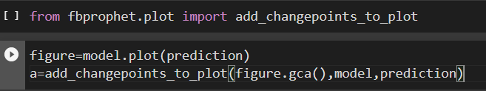
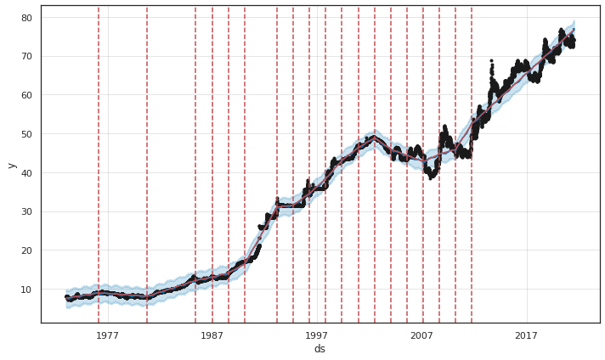
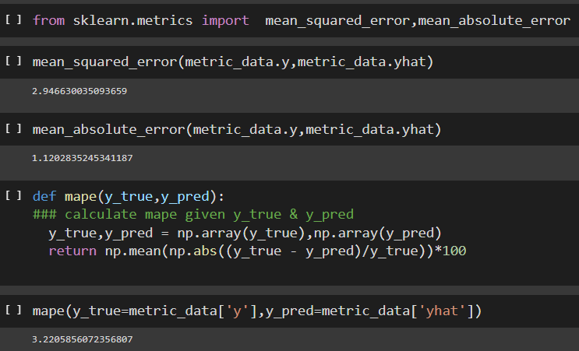
~The number of changepoints can be set by using the n_changepoints parameter when initializing prophet
~Here I calculated MAE & MSE.
~After that I calculated mape of y_true & y_pred

Slide 40
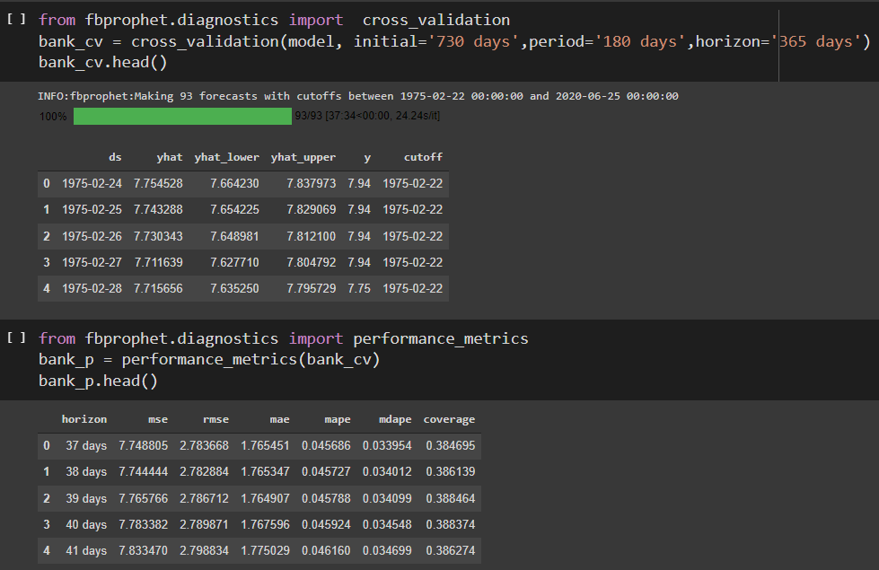
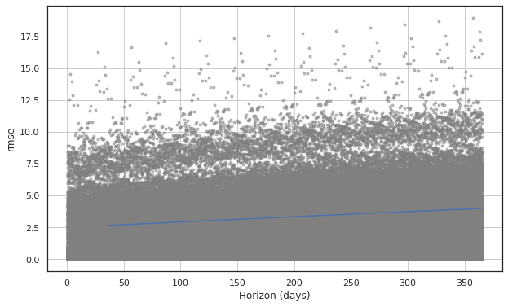
~I have done cross validation and performance metrics
~lastly I plotted cross validation metric

Slide 41
Forecasting using PyCaret

Slide 42
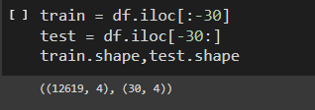
Dividing the dataset into test and train set
We divide the data into test and train set
We keep last 30 days for test set and the rest for training the model

Slide 43
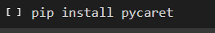
Setting up the PyCaret Module
First we import the PyCaret’s Regression library: from pycaret.regression import *
Then we setup the module as shown in the above code

Slide 44

Comparing all PyCaret models
We use the function compare_models() to find the best model based on the Mean Absolute Percentage Error
We get a list of models in the results which is sorted on the basis of MAPE

Slide 45
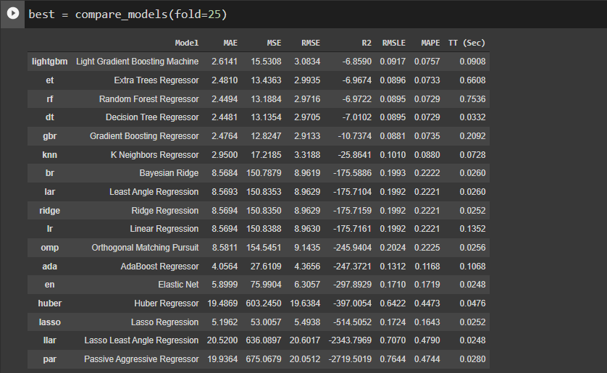
From the results table we can see that the Light Gradient Boosting Machine has the least MAPE value.
Hence, we go ahead with that.

Slide 46

Creating the Model
We create the light gradient boosting machine model with no. of folds =25

Slide 47

Tuning the model
We will tune the model in order to obtain the optimum hyperparameters
We will optimize the model based on the RMSE value

Slide 48

Predictions

Slide 49
AR Model[Autoregression]

Slide 50

~Firstly, I splitted data into train and test.
~likelihood-ratio[LLR Test]:- In llr test,specifically one found by maximization over the entire parameter space and another found after imposing some constraint.
~Then, I imported the library of model & order it (1,0) &
fit the model.

Slide 51

~ Then, I took the #Higher-Lag AR Models for Returns & after this fit the model.
~ & lastly I find the LLR test of both model.
~ After this predict by start & end & I find the rmse of AR Model.

Slide 52




~ Then, I plotted the graph of test and prediction.
~ Here, I predicted the 30 days of forecasting exchange rates.

Slide 53
Deployment
AR MODEL [AUTOREGRESSIVE]

Slide 54

~ I did deployment on AR model as final selection by using streamlit.
& here are some future predictions on exchange rates.

